Slide 1
PROJ 216 Software Project Concepts
Day 2

Slide 2
Day 2 Agenda
Project Definition
Project Plan
Software Development Lifecycle
Modern Software Development Approaches
Group Work – continue working on the Proposal Presentation for the Travel Experts project

Slide 3
Project Definition – Required Elements
Purpose – Why? (organizational objective, problem being solved, priority level)
Goals & Objectives
Success Criteria
Project Context – relation to the organization, relation to other projects
Scope Specification – defines boundaries
Out-of-Scope Specifications
Assumptions
Constraints – any business event, schedule, budget, resource, technology constraints

Slide 4
Project Definition - Required Elements Continued
Risks – any uncertain event or condition (risk) that, if occurs, could have a negative effect on the project
Stakeholders – all individuals, business unites and organizations involved in the project, their roles, and mutual relationships
All stakeholders must be identified
All major stakeholders must approve the Project Definition document
Recommended Project Approach – recommended approach to getting the work done and why it was selected over any other options (key strategies, methodologies and technologies to be used)

Slide 5
Optional Elements to Consider
Alternative Project Approaches – lists alternatives that were considered
Organizational Change Issues – planning for the change impact (customers, business processes, personnel)
Policies and Standards
Preliminary Cost, Schedule, and Resource Estimates
Supporting Documents

Slide 6
7 Key Questions
Why are we doing this?
What organizational level goals does this project support?
How does this project fit with other projects that are going on?
What is the expected benefit from this project?
Who is impacted, and who must be involved?
How will we know when we are done or if the project was successful?
What are we going to do?

Slide 7
Visual Communication(images)
Project Overview Map
Project Organization Chart
Work Breakdown Structure
…

Slide 8
Changes to Project Definition
It’s a living document
Any changes must be approved by same set of original stakeholders

Slide 9
Project Planning
Step 2 - Planning the project
G. Horine, “Absolute Beginner’s Guide to Project Management”, 3rd edition, page 59
Purpose: to develop a plan that enables the project to be executed and controlled
Initiating
Planning
Executing
Closing
Controlling

Slide 10
The Project Plan
Blueprint for the project
Starts to take from early in the project
Is updated and revised throughout the project
Initial Project Plan defines:
Goals
General objectives
Vision for the project
“Where we want to go”
Objectives
Specific, Measureable, Achievable, Realistic, Time-bound
“How we will get where we want to go”

Slide 11
Initial Project Plan
Assumptions
Must be documented to avoid problems later
Contingency plans
One for each assumption
Plan for possible problems –probability and impact
Scope
Based on all of the above
Includes what we will be doing in the project as well as specifying anything that we are not doing

Slide 12
Initial Project Plan – cont.
Define Phases, Milestones and End Products
Define the Tasks
Establish the Task Relationships
Assign Resources and Costs
Establish the Initial Plan as Your Project Baseline
Gantt Chart

Slide 13
Project Plan
Beyond the Initial Project Plan
Roles & Responsibilities
Organization chart
Reporting
Status reports
Status meeting schedule
Change control plan
Acceptance procedure
Cost estimate
Tasks & Schedule (Gantt chart)

Slide 14
Group Exercise
Working in your workshop groups for approximately 30 minutes, come up with a statement of goals, a list of objectives, assumptions, contingencies, and a scope definition for the Threaded Workshop

Slide 15
Software Development Lifecycle

Slide 16
Software Development Lifecycle -- Phases
Analysis Phases
Feasibility Study
Analysis of the Current System
Analysis of User Requirements
Selection of a Solution (Hardware and Software)
Hardware and Software Acquisition
System Design Phase
Detailed Design
System Implementation
System Maintenance

Slide 17
Research (Analysis Phases)
Also known as Analysis phase
Inspect existing software implementation features
Evaluate existing software based on businesses needs
Propose enhancements to improve software performance

Slide 18
Feasibility Study
An attempt to determine whether or not the benefits of a new system are worth the cost
Standard Activities
Review of the current system
Determine Preliminary User Requirements
Selection of Solution (Hardware and Software)
Project Plan
Economic evaluation (Cost/Benefit)
Activities common to every phase
End Product(s)
Feasibility Assessment (Cost/Benefit Analysis)

Slide 19
Current System Study
An assessment of the current situation to determine the strengths as well as the problems
Standard Activities
Document organization with end-users (Org. Chart)
Perform fact finding (interviews, observation, questionnaires)
Document everything (What, Where, When , Why, How and by Whom)
Activities common to every phase
End Product(s)
Current System Analysis Report (Problem Statement)

Slide 20
Requirements Study
A definition of the requirements for the new system
Based on the Current System
Should reflect its essential strengths and resolve its shortcomings
Includes Joint Application Design (JAD) sessions
http://www.umsl.edu/~sauterv/analysis/JAD.html
The findings indicate what is to be done (logical)

Slide 21
Hardware/Software Selection
Determine hardware and software to use in the new system.
Standard Activities
Evaluate hardware and software alternatives
System Proposal
Develop Requests for Proposal (RFP) if applicable
Update the Project Plan
Activities common to every phase
End Product(s)
System Proposal (with proposed system configuration)
Request for Proposal (RFP)
Updated Project Plan

Slide 22
Detail Design
Determine how the new system is going to work on the software and hardware to be used
Standard Activities
Design specifications
Database design
Design walk-throughs
Test plan for all testing update Project
Activities common to every phase
End Product(s)
Detail Design Specification
Test Plan

Slide 23
Construction
Programming, testing and documentation of the applications based on the requirements specifications
Standard Activities
Programming, Testing, Documentation
Activities common to every phase
End Product(s)
Documented Source Programs
User and Operations Guides
Test Results
Training Materials

Slide 24
Deployment
Correct environment is set up at the user/client site so that the system can be installed
Standard Activities
Install and test the system to ensure it is workable
Convert user data
Train the users
Activities common to every phase
End Product(s)
Updated user and operations guides
Enhancement/change requests
Corrected source programs

Slide 25
Maintenance
Two main activities:
To correct any "bugs" which arise as the result of ongoing system use
To deal with requested user enhancements, or necessary changes based on new needs, for example, changed government regulations
Change must be requested in writing, and the full SDLC process must follow
End Products include any program or documentation updates

Slide 26
Software Development Methodologies
Systems Analysis & Design with UML version 2.0: An Object-Oriented Approach, Denis, Wixom, Tegarden, 3rd Edition, John Wiley & Sons, 2009
The subsequent blue-background slides are from this book
4th edition is available, 2012
http://ca.wiley.com/WileyCDA/Section/id-302478.html?query=dennis&field=AUTHOR_LASTNAMES

Slide 27
Categories of Methodologies
Structured Design
Waterfall Development
Parallel Development
Rapid Application Development
Phased
Prototyping
Throwaway Prototyping
Agile Development
eXtreme Programming

Slide 28
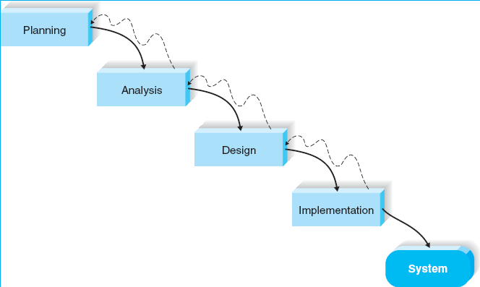
Structured Design 1
Waterfall Development

Slide 29
Waterfall Development
Original structured design methodology
Each phase must be complete before the next one starts
Client must sign-off
Any further changes done as maintenance
QA must approve deliverables
Documentation must be complete
Question: What are the advantages and disadvantages of waterfall development methodology?

Slide 30
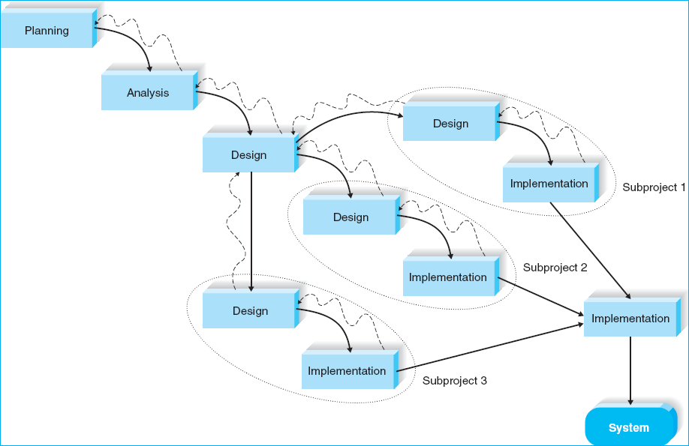
Structured Design 2
Parallel Development

Slide 31
Parallel Development
Planning, analysis, and general design up front
Independent parts developed at the same time (design, implementation)
Integration needed once parts are developed
Question: What are the main advantage of parallel development over waterfall development? What are the challenges it brings

Slide 32
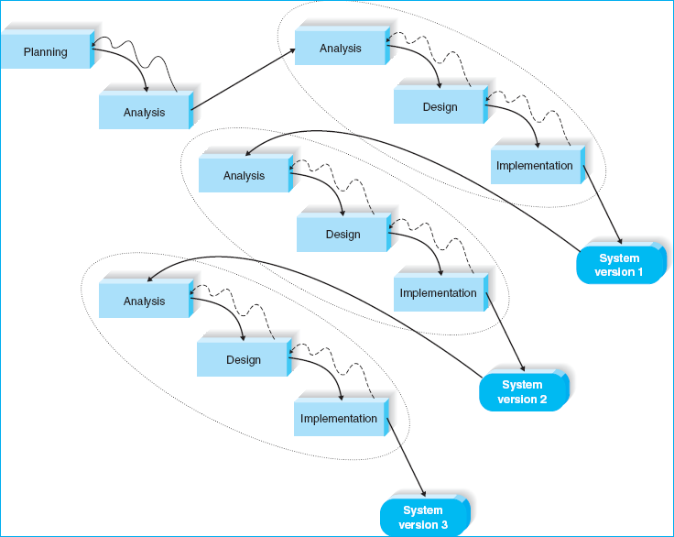
Rapid Application Development 1
Phased Development

Slide 33
RAD Phased Development
The idea of Rapid Application Development is to get part of the system developed quickly and delivered to the users
In phased development, system is developed in phases (versions) sequentially
Question: What should be included in the first version of the system?

Slide 34
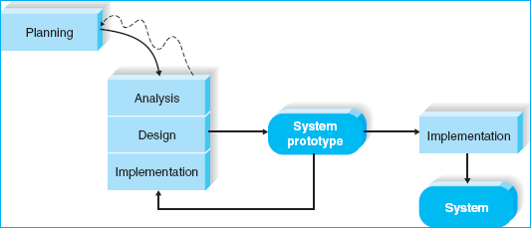
Rapid Application Development 2
System Prototyping

Slide 35
Prototyping Methodology
Starts with a “quick and dirty” program that provides minimal features; features added to it iteratively after obtaining users’ feedback
Users involved in the development process
Challenge with careful methodological analysis
Also known as Iterative Model or Spiral Model

Slide 36
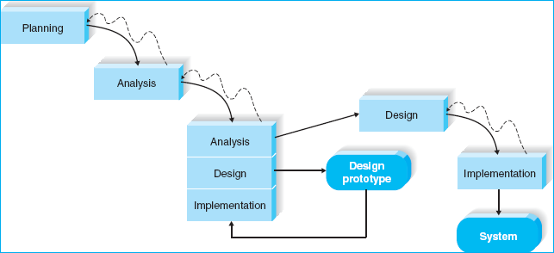
Rapid Application Development 3
Throwaway Prototyping

Slide 37
Throwaway Prototyping
Refines key issues BEFORE the system is built
Experience gained in creating the prototype facilitates development of the “real” system
Produces more stable and reliable systems

Slide 38
Selecting the Right Methodology*
Usefulness for | Waterfall | Parallel | Phased | Prototyping | Throwaway Prototyping
Unclear user requirements | Poor | Poor | Good | Excellent | Excellent
Unfamiliar technology | Poor | Poor | Good | Poor | Excellent
Complex systems | Good | Good | Good | Poor | Excellent
Reliable systems | Good | Good | Good | Poor | Excellent
Short time schedule | Poor | Good | Excellent | Excellent | Good
* - simplified

Slide 39
Selecting a Methodology: Discussion
Roanake Software Consulting Company (RSCC) is a large consulting firm with offices around the world. The company wants to build a new knowledge management system that can identify and track the expertise of individual consultants anywhere in the world based on their education and prior experience
Assume this is a new idea that has never been attempted
RSCC has an international network, but the offices in each country may use somewhat different hardware and software
RSCC management wants the system up an d running within a year.
What type of methodology would you recommend and why?
5 minutes in small groups, then compare recommendations

Slide 40
Modern Development Methods
Many approaches
http://en.wikipedia.org/wiki/List_of_software_development_philosophies
Agile Development
http://en.wikipedia.org/wiki/Agile_software_development
Many techniques and methodologies
http://en.wikipedia.org/wiki/Scrum_(development)
http://en.wikipedia.org/wiki/Extreme_Programming
…

Slide 41
Agile Development
Encourages frequent inspection and adaptation
Leadership philosophy that encourages team work, self-organization and accountability
Allows for rapid delivery of high-quality software
Aligns development with customer needs
Iterations

Slide 42
Agile Principles
Individuals and interactions over processes and tools
Working software over comprehensive documentation
Customer collaboration over contract negotiation
Responding to change over following a plan
http://agilemanifesto.org/

Slide 43
Agile Development
Phases
IRUF - Initial Requirements Up Front
Initial Architecture
Construction
Iterations between 2 & 6 weeks in length
Detailed modeling -- requirements, analysis, design, and system integration
Deployment (Implementation)
Production

Slide 44
Agile Development
Avoid “Big Modeling Up Front” syndrome
tendency to try to design entire application before starting to build
comes from construction industry
however, software is more flexible than concrete
software is more difficult to understand at start of development
needs to be iterative

Slide 45
Extreme Programming
Simple, elegant software is more valuable than complex (complicated) hard-to-maintain software
Testing
Automated
Test Driven Development (TDD)
http://en.wikipedia.org/wiki/Test-driven_development
Tests created before code is written, as code is written, after code is written, after bugs are fixed
Bugs don’t get through twice

Slide 46
Extreme Programming
When to use it:
Customers not sure what system should do
System functionality expected to change often
Tight deadlines
Small teams - 2 to 10 programmers

Slide 47
Extreme Programming
Characteristics
Programmers, managers, customers working in close proximity
Testing must be automated
Acceptance tests run often, score is published
Stand-up meeting at start of each day
Pair Programming
No overtime

Slide 48
CAMUG
Calgary Agile Methods Users’ Group
www.calgaryagile.com
Promotes networking with Calgary’s agile community
Meetings once a month, in the evening
Starts with half an hour networking session, followed by a presentation

Slide 49
Workshop: Project Presentation
Spend the rest of today working on your group project presentations
Powerpoint slides due 8 a.m. on your presentation day
Submit through learn.sait.ca (one copy per group, but each person submits)

